Slide 1
Character generation

Slide 2
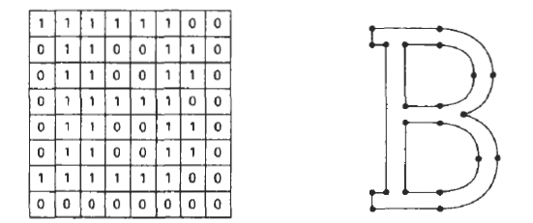
A

Slide 3
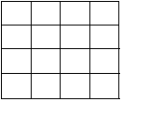
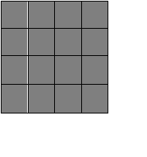
A
Cell
Grid

Slide 4
Character attributes
 | Regular | Boldface | Italic | underline
Courier New | A | A | A | A
Times New Roman | A | A | A | A
Arial | A | A | A | A
FONT
COLOUR
A
A
A
A
A

Slide 5
A
A
SIZE
A
A
A
AAAA
AAAAA
ORIENTATION
A

Slide 6
Aliasing and Anti- aliasing

Slide 7
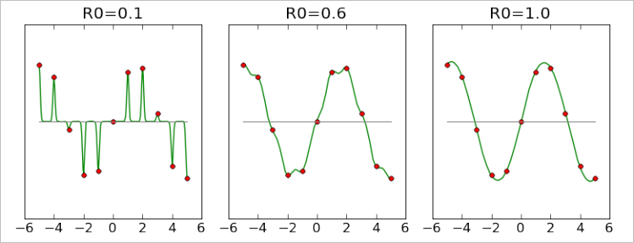
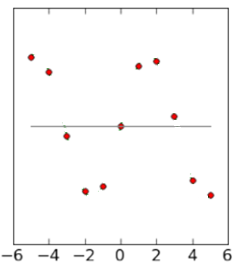

Slide 9
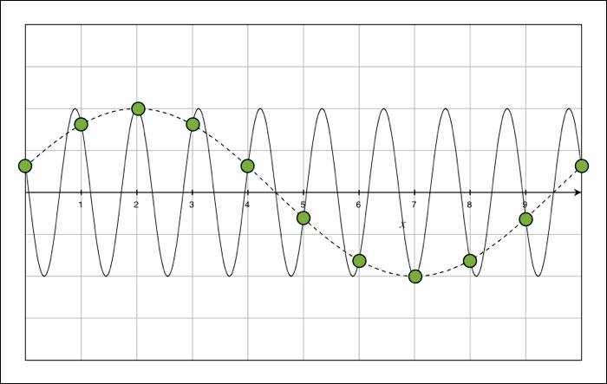
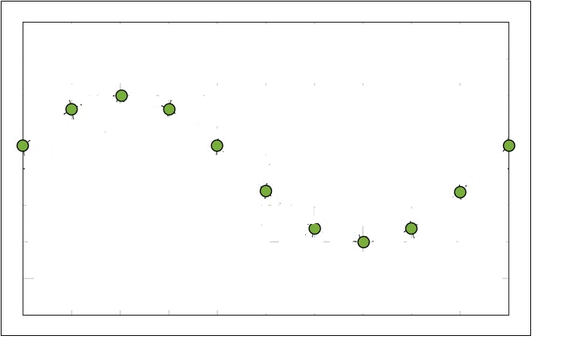

Slide 10
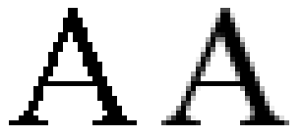
Aliasing effect
Aliasing is an effect that causes different signals to become indistinguishable
Signal sampled at low resolution and reconstructed at high resolution.
To improve the signal suffered by aliasing effect is known as anti-aliasing methods
Image: Stair-step effect
Audio: Static amplitude
Video: Slow frame rate
A

Slide 11
Anti-aliasing methods
Nyquist sampling rate

Slide 12
Super sampling
Sample object at high resolution and display at low resolution

Slide 13
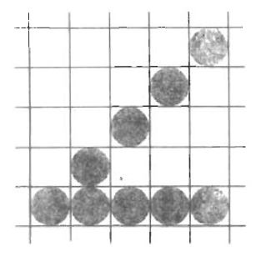
Pixel weighted mask
Intensity of a pixel is calculated from the weighted average of intensities of sub pixels and weights of the mask
1 | 2 | 1
2 | 4 | 2
1 | 2 | 1
Compensating intensity differences
Adjust intensity proportional to pixel density.

Slide 14
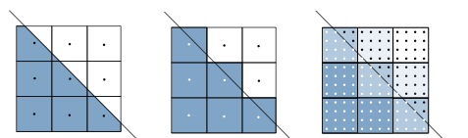
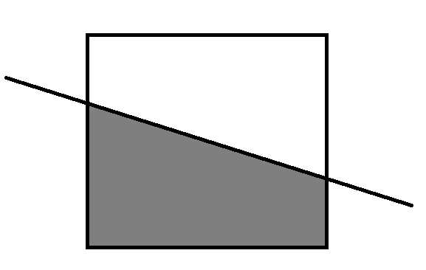
Area sampling
Intensity of a pixel is proportional to the area covered by the object
Approximately total number of sub pixels

Slide 15
END OF CHAPTER

Slide 16
http://www.xyobalancer.com/xyo-balancer-blog/signal_processing_aliasing
http://www.alglib.net/interpolation/introductiontorbfs.php
http://www.wikiwand.com/en/Aliasing

